Slide 1
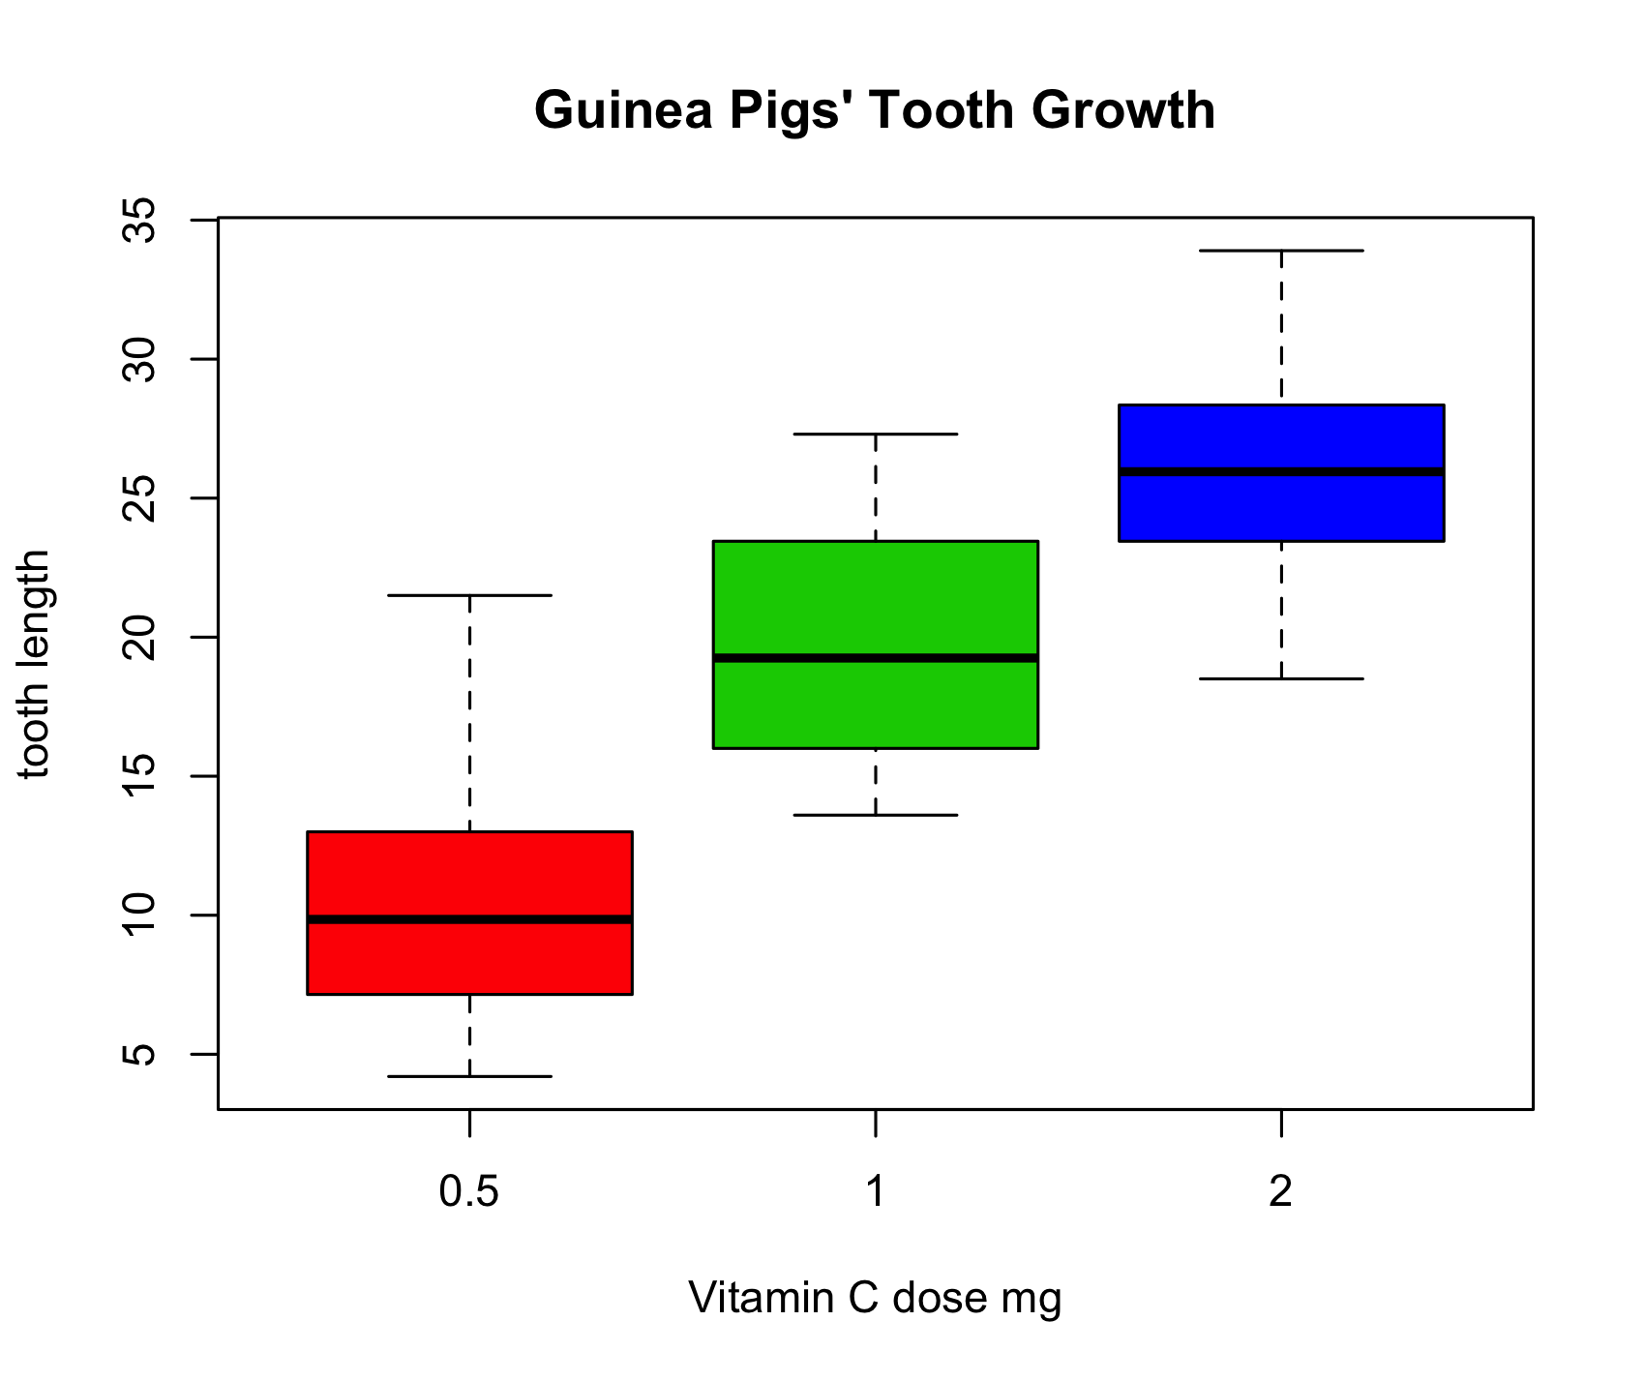
Editable vector graphics format versus raster format
Guinea Pigs' Tooth Growth
35
30
25
20
tooth length
15
10
5
0.5
1
2
Vitamin C dose mg

