Slide 1
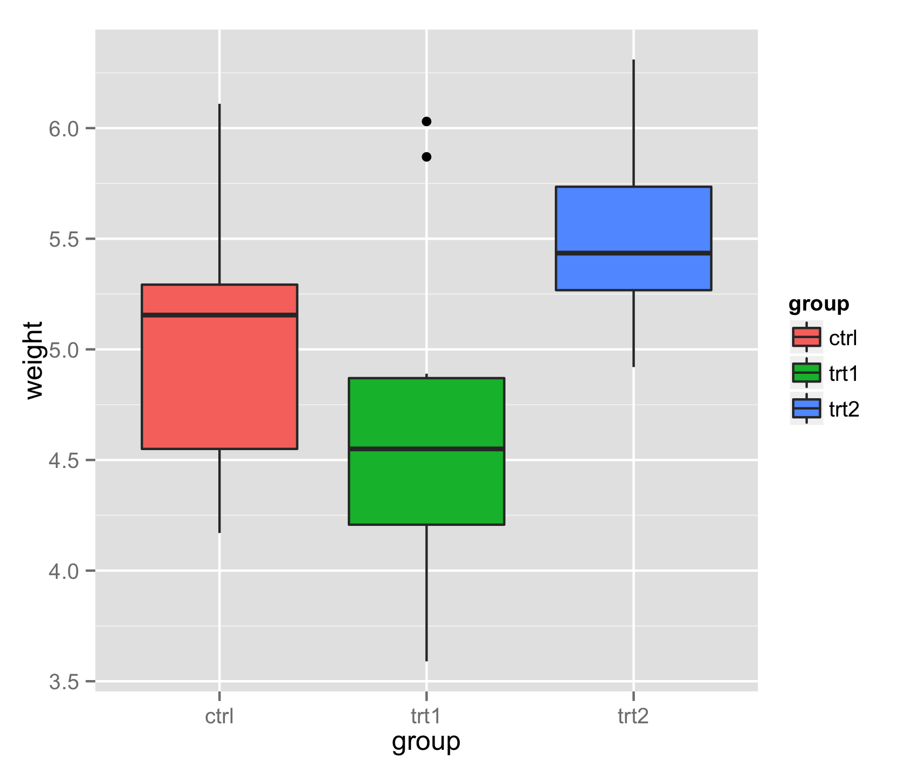
Editable vector graphics format versus raster format
6.0
5.5
group
5.0
ctrl
weight
trt1
trt2
4.5
4.0
3.5
ctrl
trt1
trt2
group

