Slide 1
Document containing plots and images
R and ReporteRs package

Slide 2
Histogram plot
This histogram is generated using iris data sets
Histogram of iris$Sepal.Width
35
30
25
20
Frequency
15
10
5
0
2.0
2.5
3.0
3.5
4.0
iris$Sepal.Width

Slide 3
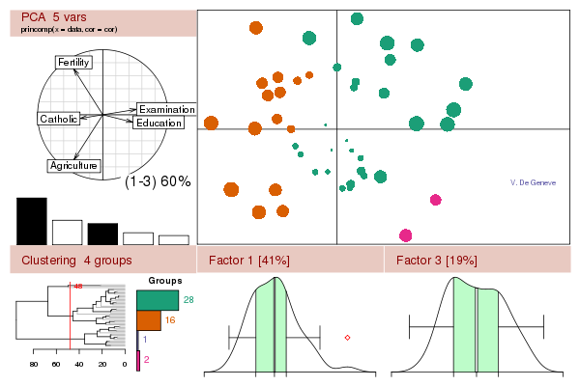
Image from R website
This image has been downloaded from R website

